Slide 1

AI Coder: Vibe Coder to Agentic Engineer
The Missing Manual
Week 3
Day 5

Slide 2
3 Weeks to Expert Agentic Coder
Core skills
Products / Features
Projects
Week 3: Agentic Engineering as an expert
Multi-Agents
Sub-Agents
Hooks
Sandboxing
Large Codebase
Workflow
Swarms
Orchestrators
Project 4: Capstone
Week 2: Vibe Engineering as a professional
Claude Code
OpenCode
others
Commands
Checkpoints
Ralph Loops
MCP
Skills
Plugins
Workflows
Team
Debugging
Project 3: SaaS Platform
Week 1: Vibe Coding for fun and profit
Agentic Coding Landscape
Foundations
AGENTS.md
Context
Cursor
Copilot, Codex
Antigravity
Project 1: YOLO
Project 2: Commercial MVP

Slide 3
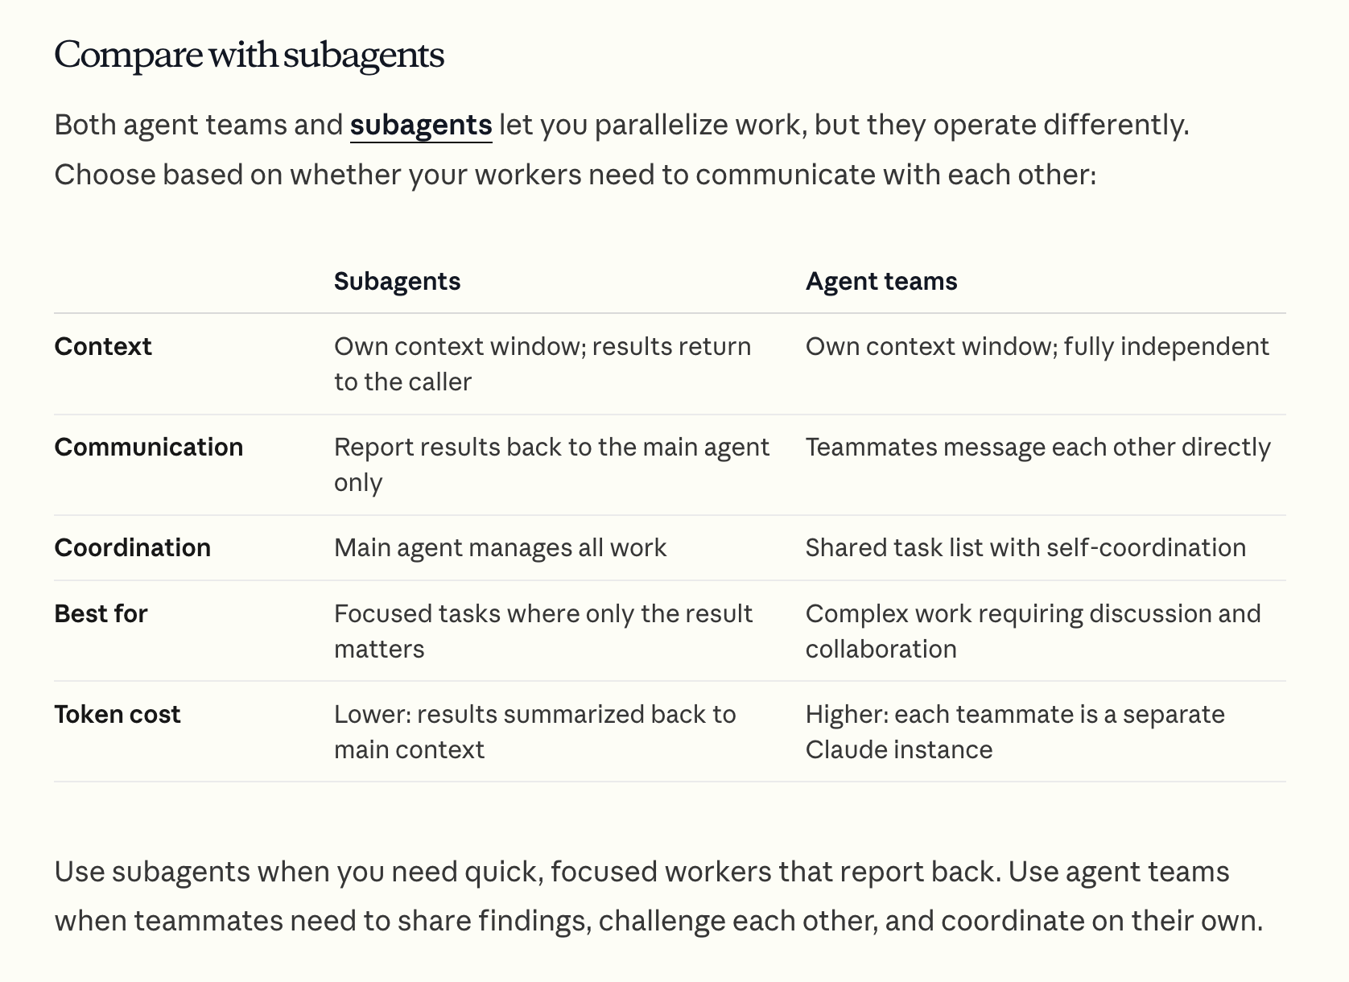
Claude Agent Teams
https://code.claude.com/docs/en/agent-teams

Slide 4
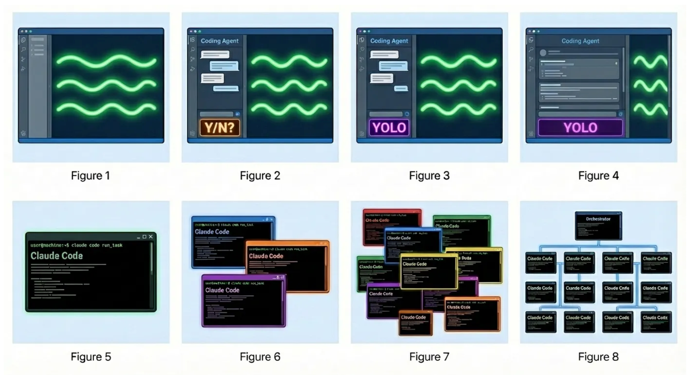
“Evolution of the Programmer in 2024–2026” by Steve Yegge
Stage 1
Stage 2
Stage 3
Stage 4
ChatGPT
AI auto-complete
Coding agent in IDE sidebar, asks permission before changes
Coding agent in IDE sidebar, YOLO mode
Coding agent in IDE main window, YOLO mode, check diffs
Stage 5
Stage 6
Stage 7
Stage 8
Coding agent in CLI, YOLO, diffs scroll by
Multi-agent in CLI, 3-5 agents
10+ agents in CLI manually managed
Agents orchestrate agents

Slide 5
We experienced 3 orchestrators
GSD
Claude Agent Teams
Gas Town
Reliable
Slow
Experimental
Faster
Chaotic
Fastest
Codex Sub-
agents

Slide 6
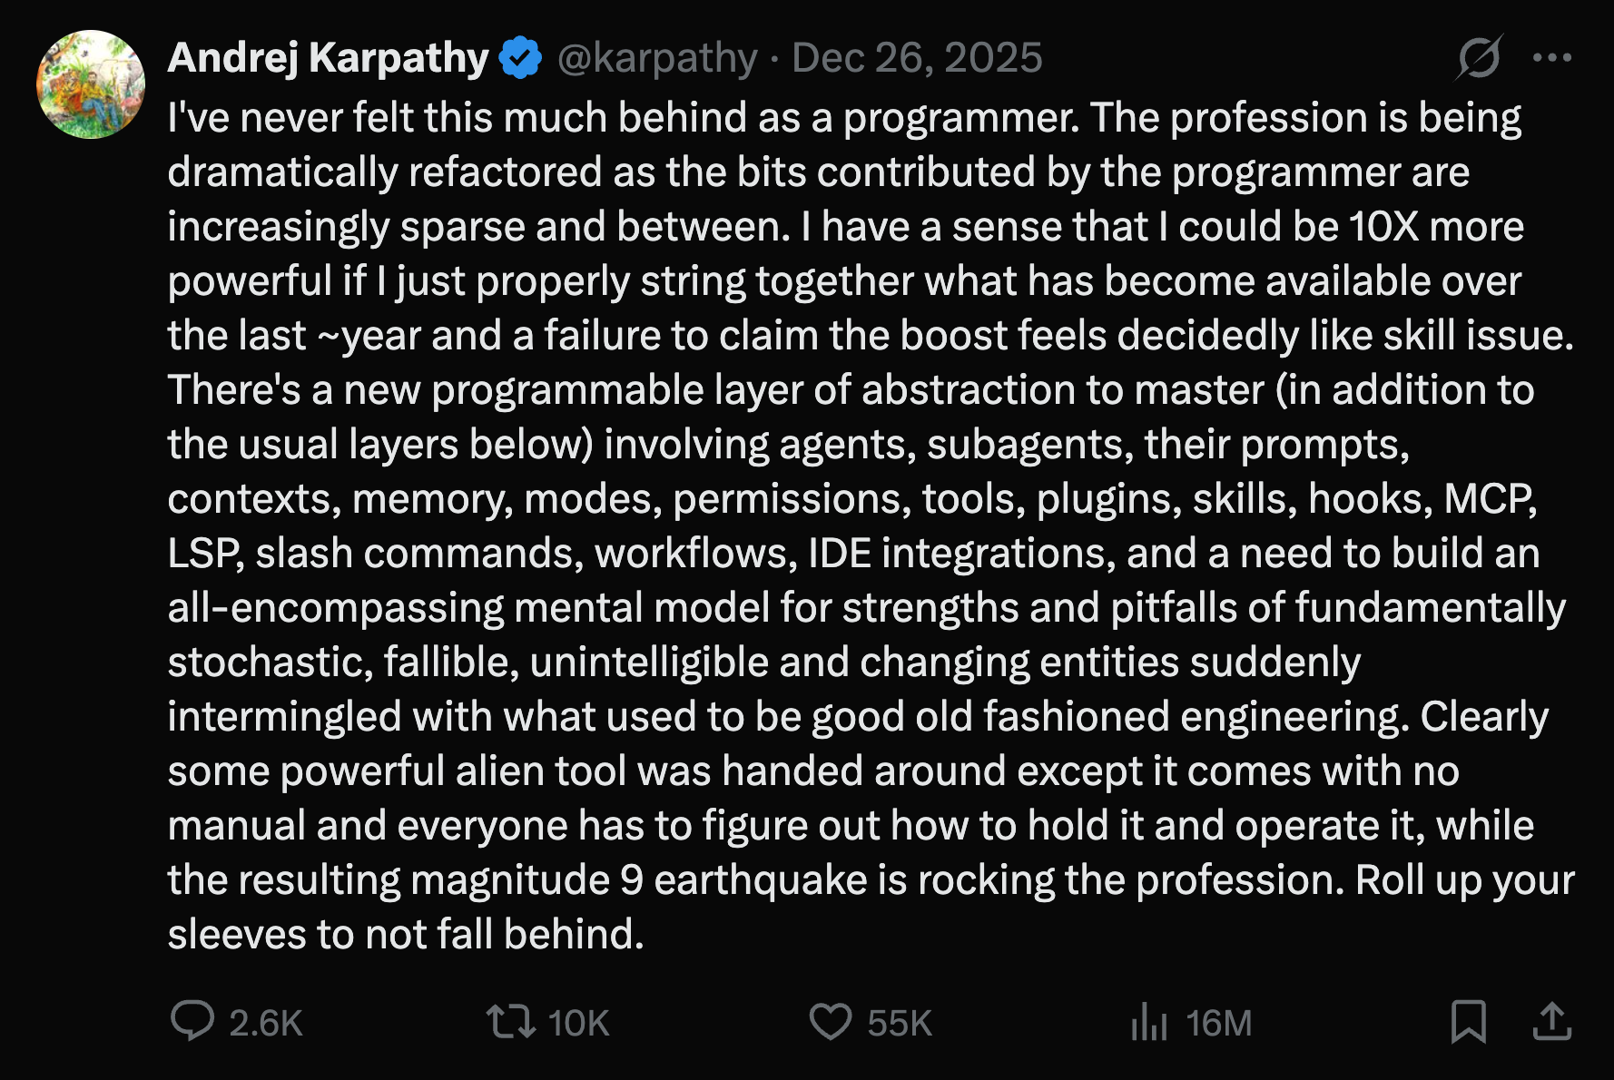
That Karpathy Tweet

Slide 7
Which approach is right
Mission critical software, large codebase, highly innovative code
Micro- manage, Approve, Frequent resets
Plan, Execute, Review, Test
SDD;
Trust but verify
MVPs, new build, risk appetite, boilerplate code
YOLO
Ralph Loops
Multi- agent
swarms,
orchestrate

Slide 8
The Major Takeaways
Pick the Coding Agent & Workflow based on:
Project Maturity & Risk Appetite
Your skills
Your preference
Follow these steps:
Pick the plugins that work for you
Add specific Skills (and MCP)
Trial & error; discard often
Use git
Use markdown docs
You own the code you deliver; never push slop

Slide 9
3 Weeks to Expert Agentic Coder
Core skills
Products / Features
Projects
Week 3: Agentic Engineering as an expert
Multi-Agents
Sub-Agents
Hooks
Sandboxing
Large Codebase
Workflow
Swarms
Orchestrators
Project 4: Capstone
Week 2: Vibe Engineering as a professional
Claude Code
OpenCode
others
Commands
Checkpoints
Ralph Loops
MCP
Skills
Plugins
Workflows
Team
Debugging
Project 3: SaaS Platform
Week 1: Vibe Coding for fun and profit
Agentic Coding Landscape
Foundations
AGENTS.md
Context
Cursor
Copilot, Codex
Antigravity
Project 1: YOLO
Project 2: Commercial MVP

Slide 10

3 Weeks to Expert Agentic Coder
Core skills
Products / Features
Projects
Week 3: Agentic Engineering as an expert
Multi-Agents
Sub-Agents
Hooks
Sandboxing
Large Codebase
Workflow
Swarms
Orchestrators
Project 4: Capstone
Week 2: Vibe Engineering as a professional
Claude Code
OpenCode
others
Commands
Checkpoints
Ralph Loops
MCP
Skills
Plugins
Workflows
Team
Debugging
Project 3: SaaS Platform
Week 1: Vibe Coding for fun and profit
Agentic Coding Landscape
Foundations
AGENTS.md
Context
Cursor
Copilot, Codex
Antigravity
Project 1: YOLO
Project 2: Commercial MVP

Slide 11

CONGRATULATIONS!!
Remember - I come with the package! https://www.linkedin.com/in/eddonner/
Post your certificate on LinkedIn and I will amplify
Consider my AI courses if you’d like to go deeper into being an AI Builder, AI Leader or AI Engineer
Most importantly: BUILD WITH CODING AGENTS!

Slide 12

AI Coder: Vibe Coder to Agentic Engineer
The Missing Manual
100%
Complete

